Slide 1
Bayes’ Theorem

Slide 2
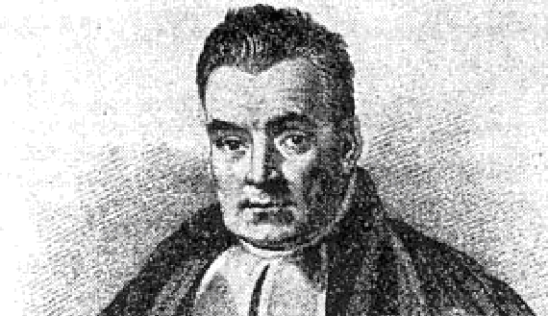
Thomas Bayes, ca. 1701-1761
Notes:
Thomas Bayes (/beɪz/; c. 1701 – 7 April 1761)^{[2][3][note a]} was an English statistician, philosopher and Presbyterian minister who is known for formulating a specific case of the theorem that bears his name: Bayes' theorem. Bayes never published what would become his most famous accomplishment; his notes were edited and published after his death.
Bayes himself might not have embraced the broad interpretation now called Bayesian, which was in fact pioneered and popularised by Pierre-Simon Laplace;^{[14]} it is difficult to assess Bayes's philosophical views on probability, since his [writing] does not go into questions of interpretation.
From https://en.wikipedia.org/wiki/Thomas_Bayes

Slide 3
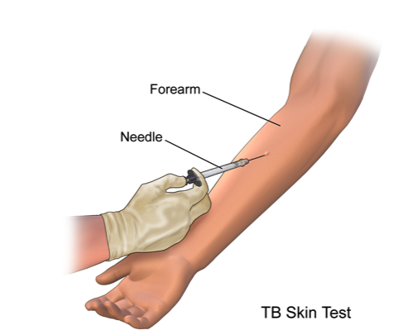
If a person tests positive for tuberculosis,
what is the probability of him/her actually having TB?
https://www.dovemed.com/common-procedures/procedures-laboratory/tuberculin-skin-test-for-tuberculosis/

Slide 4
A
Universe
http://oscarbonilla.com/2009/05/visualizing-bayes-theorem/
Notes:
See also https://arbital.com/p/bayes_rule/?l=1zq for an update guide to Bayes’ Theorem

Slide 5
A
Universe
Everybody
People with tuberculosis
People without tuberculosis

Slide 6
If I pick a random person in the universe, what’s the probability of him/her having tuberculous?
A
Universe
Notes:
Pause to ask how we calculate this.
Note: the vertical bars denote the number of elements in the set (=cardinality of the set). |A| = cardinality of set A = number of people in the universe with TB

Slide 7
B
Universe
Notes:
Now consider a different set of people in the universe

Slide 8
People who test positive for TB
B
Universe
Everybody
People who test negative for TB

Slide 9
If I pick a random person in the universe, what’s the probability of him/her testing positive for TB?
B
Universe
Notes:
Instead of quantifying probability of having TB, not we are talking about testing positive
Before moving on ask if we expect these quantities to be the same (that is, P(A) = P(B)?) – Probably not!

Slide 10
A
AB
B
Universe
Notes:
The quality of the test determines how well these two circles overlap

Slide 11
People without TB
that test positive
People with tuberculosis that test negative
A
AB
B
Universe
People without TB that test negative
People with TB that test positive

Slide 12
If I pick a random person in the universe, what’s the probability of him/her having tuberculous AND testing positive for it?
A
AB
B
Universe
Joint Probability

Slide 13
If I pick a random person in the universe, what’s the probability of him/her having tuberculous AND testing positive for it?
A
AB
B
Universe
AB
Joint Probability
Notes:
The joint probability is talking specifically about the overlap between A and B
Remind students that P(A,B) <= P(A) and also P(A, B) <= P(B)

Slide 14
If I pick a random person that tested positive, what’s the probability of him/her having tuberculous?
A
AB
B
Universe
Conditional Probability
Notes:
Pause to ask “How could this quantity be calculated?”

Slide 15
If I pick a random person that tested positive, what’s the probability of him/her having tuberculous?
A
AB
B
Universe
AB
B
Conditional Probability
Notes:
Think of this conditional probability as zeroing in on the “test positive” group

Slide 16
If I pick a random person that tested positive, what’s the probability of him/her having tuberculous?
A
AB
B
Universe
AB
B
Notes:
Divide top and bottom by number of people in universe
Back to previous results: joint probability divided by probability that person will test positive

Slide 17
If I pick a random person that has tuberculous, what’s the probability of him/her testing positive?
A
AB
B
Universe
Conditional Probability

Slide 18
If I pick a random person that has tuberculous, what’s the probability of him/her testing positive?
A
AB
B
Universe
A
AB
Notes:
Think of this conditional probability as zeroing in on the “has TB” group
Divide top and bottom by number of people in universe
Back to previous results: joint probability divided by probability that person has TB

Slide 19
A
AB
B
Universe
P( test positive | has TB )
P( has TB | test positive )

Slide 20
A
AB
B
Universe
P( test positive | has TB )
P( has TB | test positive )

Slide 21
A
AB
B
Universe
P( test positive | has TB )
P( has TB | test positive )

Slide 22
A
AB
B
Universe
P( test positive | has TB )
P( has TB | test positive )

Slide 23
A
AB
B
Universe
P( test positive | has TB )
P( has TB | test positive )
P( has TB )
P( test positive )
Notes:
Prep for next slide:
If I want to calculate the probability that someone has TB given that they tested positive, I will just isolate this term by moving the P(test positive) term over to the other side

Slide 24
If a person tests positive for tuberculosis, what is the probability of him/her actually having TB?
A
Universe
AB
B
P( test positive | has TB )
P( has TB )
P( has TB | test positive )
P( test positive )
BAYES
THEOREM

Slide 25
EXAMPLE

Slide 26
The United States sees about 3 new cases of TB per 100,000 people each year. An estimated 80% of people who have TB will yield a positive skin test. An additional 1% of people that do not have the disease will also test positive. If a person from the US first tests positive during a yearly TB screening, what is the probability that he/she actually has tuberculous?
Notes:
First step is to identify what the problem would like us to answer.
Extra info about TB in the US:
I’ve tried to be as realistic as possible with these numbers. Most coming from: https://www.cdc.gov/nchhstp/newsroom/docs/factsheets/tb-in-the-us-a-snapshot.pdf (about TB prevalence in the US) and https://www.atsjournals.org/doi/full/10.1164/ajrccm.161.4.16141 (specifically about the TB skin test)
In 2017, there were 2.8 new cases per 100,000 individuals in the US. This example also alludes to yearly screening for TB, which we obviously don’t do because of this incredibly low prevalence.
This also assumes that person has no prior knowledge of being infected or coming in close contact with an infected individual.
As many as 13 million (5%) of US has the latent form of TB infection but these are not new, active cases per year.

Slide 27
The United States sees about 3 new cases of TB per 100,000 people each year. An estimated 80% of people who have TB will yield a positive skin test. An additional 1% of people that do not have the disease will also test positive. If a person from the US first tests positive during a yearly TB screening, what is the probability that he/she actually has tuberculous?
Recall Bayes’ Theorem:
P( test positive | has TB )
P( has TB )
P( has TB | test positive )
P( test positive )
Notes:
First step is to identify what the problem would like us to answer

Slide 28
The United States sees about 3 new cases of TB per 100,000 people each year. An estimated 80% of people who have TB will yield a positive skin test. An additional 1% of people that do not have the disease will also test positive. If a person from the US first tests positive during a yearly TB screening, what is the probability that he/she actually has tuberculous?
P( has TB ) = 3 cases /100,000 people = 0.00003

Slide 29
The United States sees about 3 new cases of TB per 100,000 people each year. An estimated 80% of people who have TB will yield a positive skin test. An additional 1% of people that do not have the disease will also test positive. If a person from the US first tests positive during a yearly TB screening, what is the probability that he/she actually has tuberculous?
P( test positive | has TB ) = 0.80

Slide 30
The United States sees about 3 new cases of TB per 100,000 people each year. An estimated 80% of people who have TB will yield a positive skin test. An additional 1% of people that do not have the disease will also test positive. If a person from the US first tests positive during a yearly TB screening, what is the probability that he/she actually has tuberculous?
P( test positive )
= P( test positive, has TB )
+ P( test positive, does not have TB )
Notes:
How to convert this joint probability into information that you do have?

Slide 31
The United States sees about 3 new cases of TB per 100,000 people each year. An estimated 80% of people who have TB will yield a positive skin test. An additional 1% of people that do not have the disease will also test positive. If a person from the US first tests positive during a yearly TB screening, what is the probability that he/she actually has tuberculous?
0.80
0.00003
P( test positive )
= P( test positive | has TB ) P( has TB )
+ P( test positive | no TB ) P( no TB )
0.01
1 - 0.00003

Slide 32
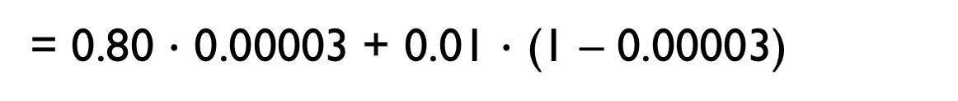
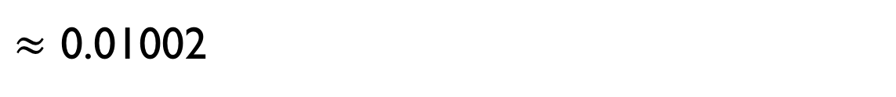
The United States sees about 3 new cases of TB per 100,000 people each year. An estimated 80% of people who have TB will yield a positive skin test. An additional 1% of people that do not have the disease will also test positive. If a person from the US first tests positive during a yearly TB screening, what is the probability that he/she actually has tuberculous?
P( test positive )
= P( test positive | has TB ) P( has TB )
+ P( test positive | no TB ) P( no TB )
= 0.80 $∙$ 0.00003 + 0.01 $∙$ (1 – 0.00003)
$≈$ 0.01002

Slide 33
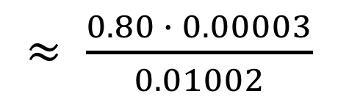
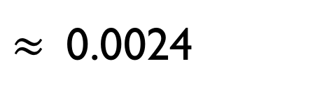
The United States sees about 3 new cases of TB per 100,000 people each year. An estimated 80% of people who have TB will yield a positive skin test. An additional 1% of people that do not have the disease will also test positive. If a person from the US first tests positive during a yearly TB screening, what is the probability that he/she actually has tuberculous?
P( test positive | has TB )
P( has TB )
P( has TB | test positive )
P( test positive )
$≈$ $\frac{0.80 ∙ 0.00003}{0.01002}$
$≈$0.0024
ONLY 0.24%!
Notes:
This is why we don’t have yearly screenings for TB in the United States!
“The yearly incidence of new tuberculosis infection in the general U.S. population without known exposure to tuberculosis is estimated to be 0.1– 0.01%. Therefore, screening of groups without a known or likely exposure to M. tuberculosis is not recommended. In these groups, a false-positive result is more likely than a true-positive result.”
https://www.atsjournals.org/doi/full/10.1164/ajrccm.161.4.16141

Slide 34
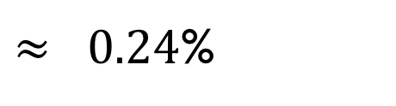
The United States sees about 3 new cases of TB per 100,000 people each year. An estimated 80% of people who have TB will yield a positive skin test. An additional 1% of people that do not have the disease will also test positive. If a person from the US first tests positive during a yearly TB screening, what is the probability that he/she actually has tuberculous?
A
B
US Population
$≈ 0.24$%
Notes:
Returning to our universe, which is now the US population
AB (having TB and testing positive) represents very small portion of area of B (testing positive)
Diagrams not drawn to scale – this effect should be even more prominent

Slide 35
RECAP

Slide 36
A
Universe
AB
B
P( test positive | has TB )
P( has TB )
P( has TB | test positive )
P( test positive )
BAYES
THEOREM

Slide 37
P( test positive | has TB )
P( has TB )
A
Universe
AB
B
P( has TB | test positive )
P( test positive )
likelihood
posterior
prior
Another perspective:
Updating Knowledge
evidence
Notes:
From this view we are starting with our prior knowledge about how many new TB cases the US sees each year, then once we know that a person has tested positive our knowledge about how likely someone is to have TB is updated
Next up: See Naïve Bayes lesson for use of Bayes’ Theorem in a classifier

